Slide 1
Monitoring and Managing Kafka
Chatchai Kongmanee
Specialist Solution Architect
Red Hat, Thailand

Slide 2
Kafka tools

Slide 3
Configs
bin/kafka-configs.sh
Can be used to monitor and manage configuration
Broker configuration
Default configuration of topics
Can be used by connecting to Kafka as well as to ZooKeeper

Slide 4
Topics
bin/kafka-topics.sh
Can be used to monitor and manage topics
Since Kafka 2.3 can be used by connecting to Kafka as well as to ZooKeeper
Can describe topics
Topic configuration
Partition / replica assignments
In-sync replicas

Slide 5
Consumer Groups
bin/kafka-consumer-groups.sh
Can be used to list consumer groups and their offsets
Can also reset offsets
To specific offset
To beginning or end of a partition
To specific time
Connects to Kafka

Slide 6
ACLs
bin/kafka-acls.sh
Lists and manages ACLs
Works only with SimpleACLAuthorizer which stores ACLs in ZooKeeper
Can list the APIs by user or by resource (e.g. topic)
Can manage the ACLs as well
Connects to Kafka

Slide 7
Leader Election
bin/kafka-leader-election.sh
Can be used to select leaders for partitions
To move the leader to different broker
To elect the leader from unclean partitions
Connects to Kafka
Notes:
Allowing the unclean broker to become leader as a last resort increases availability at the expense of durability, as new reads and writes are still possible for the topic partition.
In this failure scenario, if unclean leader election was not enabled, then clients would have to wait for a consistent in-sync replica to come back online before it can perform further reads and writes to that topic partition. This configuration therefore favours durability over availability.

Slide 8
Reassigning Partitions
bin/kafka-reassign-partitions.sh
Can be used to re-assign partitions to another broker
Important after scaling the cluster or if traffic increases for some topics
Will create new replica, replicate all data to the new broker and only then delete the old replica
Once in progress cannot be changed, only canceled
Throttling can be used when the data are being replicated to new broker
Connects to Kafka
Cruise Control can be used as an alternative to re-assigning partitions manually

Slide 9
Log directories
bin/kafka-log-dirs.sh
Useful when broker is configured to use multiple directories for commit logs
For example when using JBOD (just a bunch of disks) storage
Lists which partitions/replicas are stored in which directory / on which disk
Connects to Kafka
Notes:
Disk Replacement
Stop the broker that has a faulty disk:
Replace the disk.
Mount the disk.
Set up the directory structure on the new disk the same way as it was set up on the previous disk.
Start the broker:
The disk is replaced. The Kafka broker re-creates topic partitions in the same directory by replicating data from other brokers.

Slide 10
Others
bin/kafka-broker-api-versions.sh
Lists the versions of APIs supported by the different brokers
bin/kafka-replica-verification.sh
Verifies that replicas of single partition are identical (have the same data)
bin/kafka-delete-records.sh
Can delete records from partition based on their offset
bin/kafka-dump-log.sh
Dumps the commit log into console for analysing corrupted logs etc.
Notes:
Java based API for monitoring and managing Kafka brokers
Most of the CLI utilities connecting to Kafka are based on Admin API
Always up to date with the latest broker release
Can be used to automate tasks and build custom tools
Supported part of AMQ Streams

Slide 11
Scaling Kafka clusters

Slide 12
Adding and removing brokers from a Kafka cluster
The primary way of increasing throughput for a topic is to increase the number of partitions for that topic. The partitions allow the load for that topic to be shared between the brokers in the cluster. When the brokers are constrained by a resource (typically I/O), then using more partitions will not yield an increase in throughput. Instead, you must add brokers to the cluster.
When you add an extra broker to the cluster, AMQ Streams does not assign any partitions to it automatically. You have to decide which partitions to move from the existing brokers to the new broker. Once the partitions have been redistributed between all brokers, each broker should have a lower resource utilization.
Before you remove a broker from a cluster, you must ensure that it is not assigned to any partitions. You should decide which remaining brokers will be responsible for each of the partitions on the broker being decommissioned. Once the broker has no assigned partitions, you can stop it.
When you add or remove brokers,
you can use the kafka-reassign-partitions.sh to assign partitions.
You can also use Cruise Control to incorporate changes to the number of brokers when rebalancing a Kafka cluster.

Slide 13
Scaling up a Kafka cluster
Create a configuration file for the new broker using the same settings as for the other brokers in your cluster, except for broker.id which should be a number that is not already used by any of the other brokers.
Start the new Kafka broker passing the configuration file you created in the previous step as the argument to the kafka-server-start.sh script
Verify that the Kafka broker is running.
Repeat the above steps for each new broker.
Run the partition reassignment using the kafka-reassign-partitions.sh or cruise control
If you are going to throttle replication you can also pass the throttle option with an inter-broker throttled rate in bytes per second.
Verify reassignment
Reassign
Broker
Broker
Broker
Broker
Broker
Broker
Broker
Broker

Slide 14
Scaling down a Kafka cluster
Run the partition reassignment using the kafka-reassign-partitions.sh or cruise control
Periodically verify whether the reassignment has completed
Check that each broker being removed does not have any live partitions in its log (log.dirs).
ls -l <LogDir> | grep -E '^d' | grep -vE '[a-zA-Z0-9.-]+\.[a-z0-9]+-delete$'
If a log directory does not match the regular expression \.[a-z0-9]-delete$, active partitions are still present. If you have active partitions, check the reassignment has finished or the configuration in the reassignment JSON file. You can run the reassignment again. Make sure that there are no active partitions before moving on to the next step.
Stop the broker.
/opt/kafka/bin/kafka-server-stop.sh
Confirm that the Kafka broker has stopped with jcmd | grep kafka
Reassign
Broker
Broker
Broker
Broker
Broker
Broker
Broker
Broker

Slide 15
Scaling up a ZooKeeper cluster
Dynamic reconfiguration is enabled in the ZooKeeper configuration file (reconfigEnabled=true).
ZooKeeper authentication is enabled and you can access the new server using the authentication mechanism.
Add a server to the ZooKeeper cluster and then start ZooKeeper.
Note the IP address and configured access ports of the new server.
Start a zookeeper-shell session for the server. Run the following command from a machine that has access to the cluster
/opt/kafka/bin/zookeeper-shell.sh <ip-address>:<zk-port>
In the shell session, with the ZooKeeper node running, enter the following line to add the new server to the quorum as a voting member:
reconfig -add server.4=172.17.0.4:2888:3888:participant;172.17.0.4:2181
Where <positive-id> is the new server ID 4.
For the two ports, <port1> 2888 is for communication between ZooKeeper servers, and <port2> 3888 is for leader election.
The new configuration propagates to the other servers in the ZooKeeper cluster; the new server is now a full member of the quorum.
Repeat steps 1-4 for the other servers that you want to add.

Slide 16
Scaling down a ZooKeeper cluster
Dynamic reconfiguration is enabled in the ZooKeeper configuration file (reconfigEnabled=true).
ZooKeeper authentication is enabled and you can access the new server using the authentication mechanism.
Perform the following steps for each ZooKeeper server, one at a time:
Log in to the zookeeper-shell on one of the servers that will be retained after the scale down (for example, server 1).
Remove a server, for example server 5.
reconfig -remove 5
Deactivate the server that you removed.
Repeat steps to reduce the cluster size.

Slide 17
Cluster balancing

Slide 18
Why is it needed?
Newly created partitions/replicas are distributed between broker nodes as round robin
Doesn’t look at the current load of the different broker nodes
Doesn’t know which partitions will be big and which will be small
Doesn’t know which partitions will be busy
Partition size changes over time
Even a perfectly balanced cluster might get out of balance over time
After scaling up the Kafka cluster, the existing topics will not move there on their own
Only newly created topics will use the new brokers

Slide 19
Partition size changes
1
2
3

Slide 20
Scaling doesn’t help
1
2
3
4

Slide 21
Rebalance
1
2
3
4

Slide 22
Rebalancing cluster
Collect all required metrics from the brokers
Find the new optimal distribution of partitions / replicas on the cluster
There is not just one optimum
Storing most data with limited disk space?
Optimal network, CPU or RAM utilization?
Distribution of leader replicas?
Rack awareness?
Doing this manually is not easy

Slide 23
Rebalancing cluster
Once you find the optimal distribution or partitions / replicas
Prepare the input files for kafka-reassign-partitions.sh tool
Trigger the reassignment
Monitor its progress
Reassigning partitions can be a slow process because it can require moving lots of data between brokers. To avoid this having a detrimental impact on clients it is possible to throttle the reassignment.

Slide 24
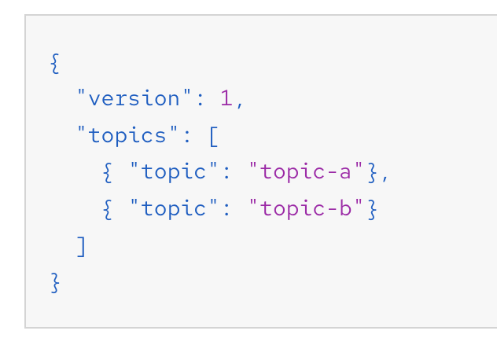
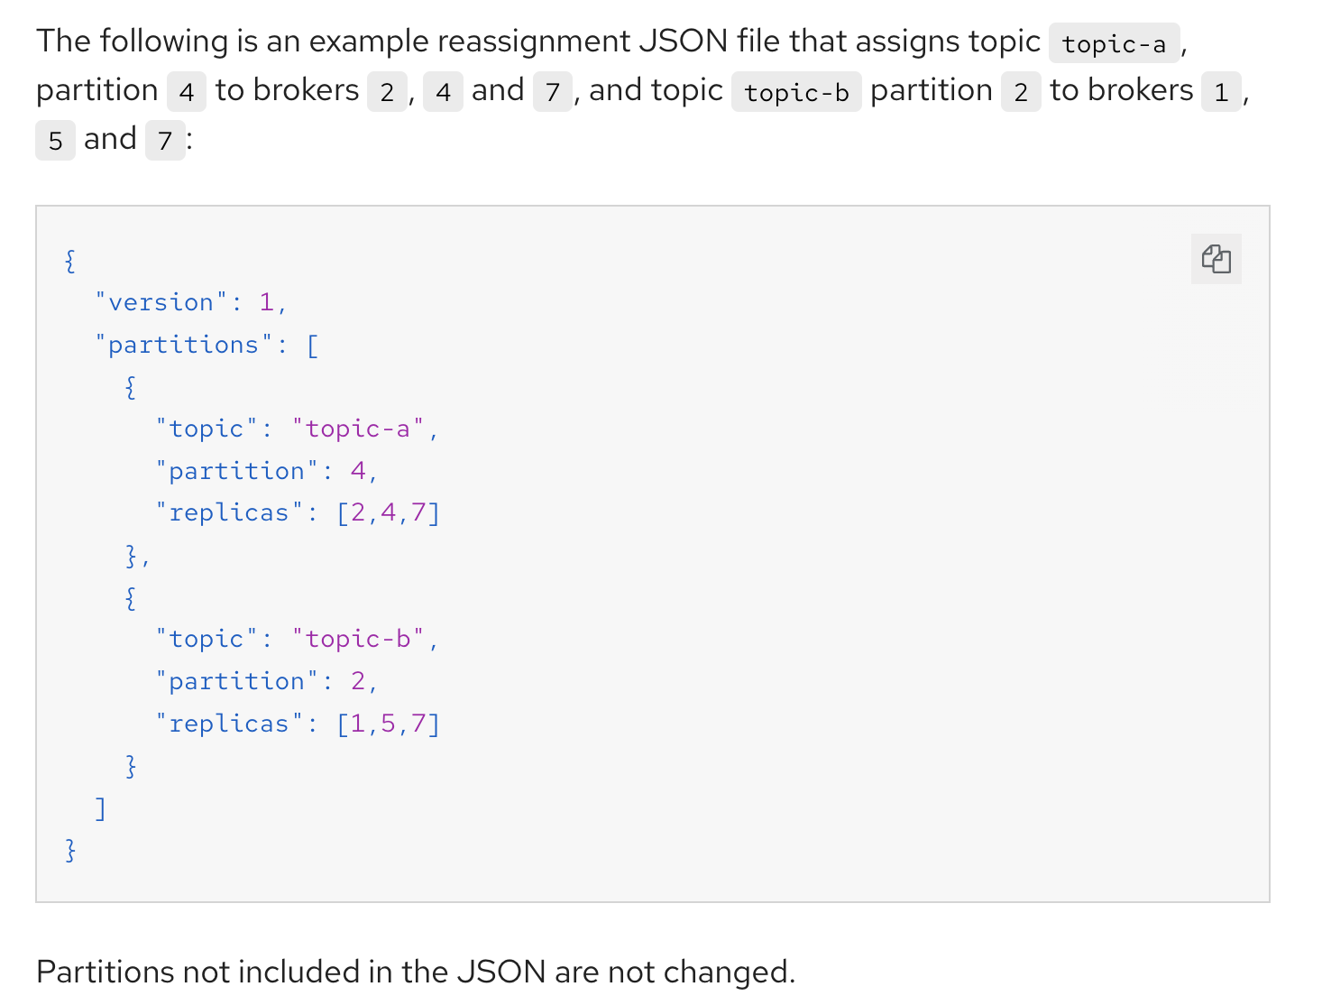
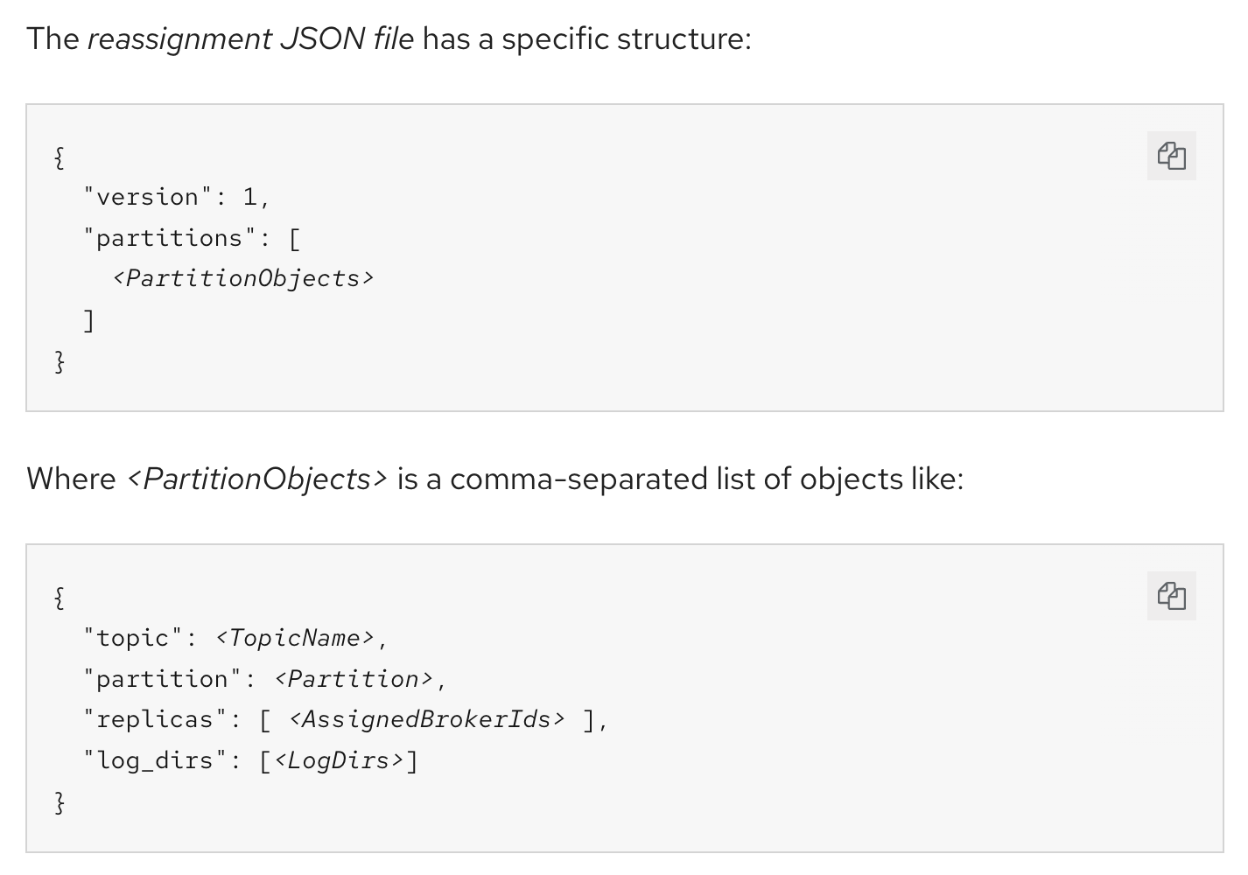
Generating reassignment file
kafka-reassign-partitions.sh --bootstrap-server <bootstrap_address> --topics-to-move-json-file <topics_file> --broker-list <broker_list> --generate
--broker-list : move topic from broker
Example of topics to move json file
Example of The reassignment JSON file output

Slide 25
Run reassign partition
Run the partition reassignment using the kafka-reassign-partitions.sh command line tool.
kafka-reassign-partitions.sh --bootstrap-server localhost:9092 --reassignment-json-file reassignment.json --throttle 5000000 --execute
--reassignment-json-file from generate command or manual
--throttle : option for inter-broker throttled rate in bytes per second
This command will print out two reassignment JSON objects.
The first records the current assignment for the partitions being moved. (save this to a file for revert).
The second JSON object is the target reassignment you have passed in your reassignment JSON file.
If you need to change the throttle during reassignment you can use the same command line with a different throttled rate. For example:
kafka-reassign-partitions.sh --bootstrap-server localhost:9092 --reassignment-json-file reassignment.json --throttle 10000000 --execute
Verify reassignment has completed using
kafka-reassign-partitions.sh --bootstrap-server localhost:9092 --reassignment-json-file reassignment.json --verify

Slide 26
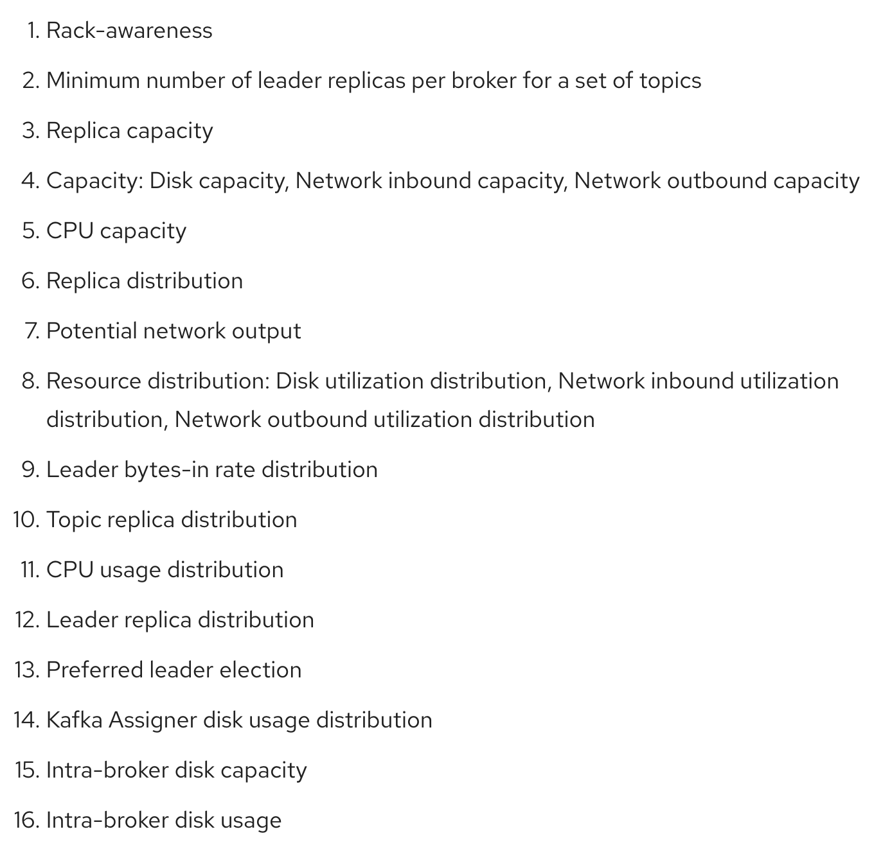
Open Source project developed by LinkedIn
GA Now (2.2)
Supports many different optimization goals
Hard goals are preset and must be satisfied for an optimization proposal to be successful.
Main goals are inherited from Cruise Control. Some are preset as hard goals. Main goals are used in optimization proposals by default. Goals that are not listed in the main optimization goals are not available for use in Cruise Control operations.
Default goals are the same as the main goals by default. You can specify your own set of default goals.
User-provided goals — runtime parameters
See all available goals in Cruise Control Wiki
Cruise Control

Slide 27
Cruise Control
Runs in a separate deployment
Configured
Default goals configuration
Broker capacity (e.g. network, CPU, storage)
Logging, resources, ...
Has its own metrics collector running inside Kafka cluster
generate and approve an optimization proposal by making a request to one of the following API endpoints.
/rebalance endpoint to run a full rebalance.
/add_broker endpoint to rebalance after adding brokers when scaling up a Kafka cluster.
/remove_broker endpoint to rebalance before removing brokers when scaling down a Kafka cluster.

Slide 28

Rebalancing with Cruise Control
Cruise Control optimizes the distribution
Rebalance
Rebalance Request
Proposal
User approves the proposal

Slide 29
On RHEL
Cruise Control ZIP is available in AMQ Streams download (unzip to deploy!)
Metrics collectors on brokers need to be installed manually
Cruise Control REST API can be used to interact with it

Slide 30
Deploying the Cruise Control Metrics Reporter
In the Kafka configuration file (/opt/kafka/config/server.properties) configure the Cruise Control Metrics Reporter:
Add the CruiseControlMetricsReporter class to the metric.reporters configuration option. Do not remove any existing Metrics Reporters.
metric.reporters=com.linkedin.kafka.cruisecontrol.metricsreporter.CruiseControlMetricsReporter
Enable the Cruise Control Metrics Reporter to create the __CruiseControlMetrics topic.
cruise.control.metrics.topic.auto.create=true
cruise.control.metrics.topic.num.partitions=1
cruise.control.metrics.topic.replication.factor=1
Configure SSL, if required.

Slide 31
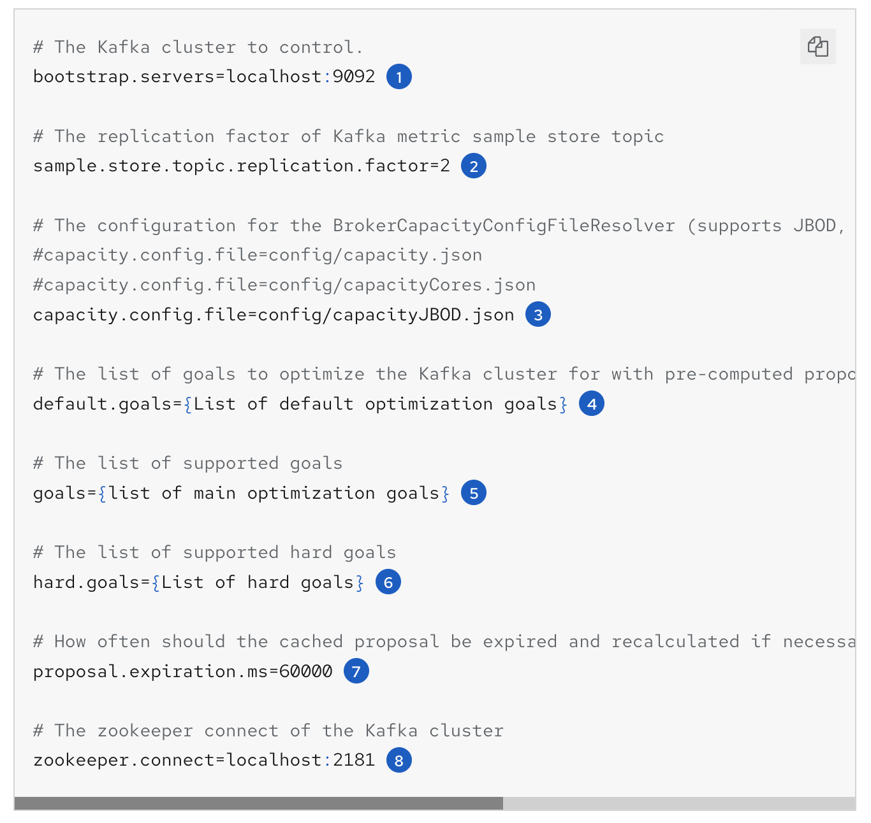
Configuring and starting Cruise Control
Edit the Cruise Control properties file (/opt/cruise-control/config/cruisecontrol.properties).
Host and port numbers of the Kafka broker (always port 9092).
Replication factor of the Kafka metric sample store topic.
The configuration file that sets the maximum capacity limits for broker resources.
Comma-separated list of default optimization goals, using fully-qualified domain names (FQDNs).
Comma-separated list of main optimization goals, using FQDNs.
Comma-separated list of hard goals, using FQDNs. Seven of the main optimization goals are already set as hard goals;
The interval, in milliseconds, for refreshing the cached optimization proposal that is generated from the default optimization goals.
Host and port numbers of the ZooKeeper connection (always port 2181).
Start cruise control
kafka-cruise-control-start.sh config/cruisecontrol.properties <port_number>
Verify cruise control
curl 'http://HOST:PORT/kafkacruisecontrol/state'

Slide 32
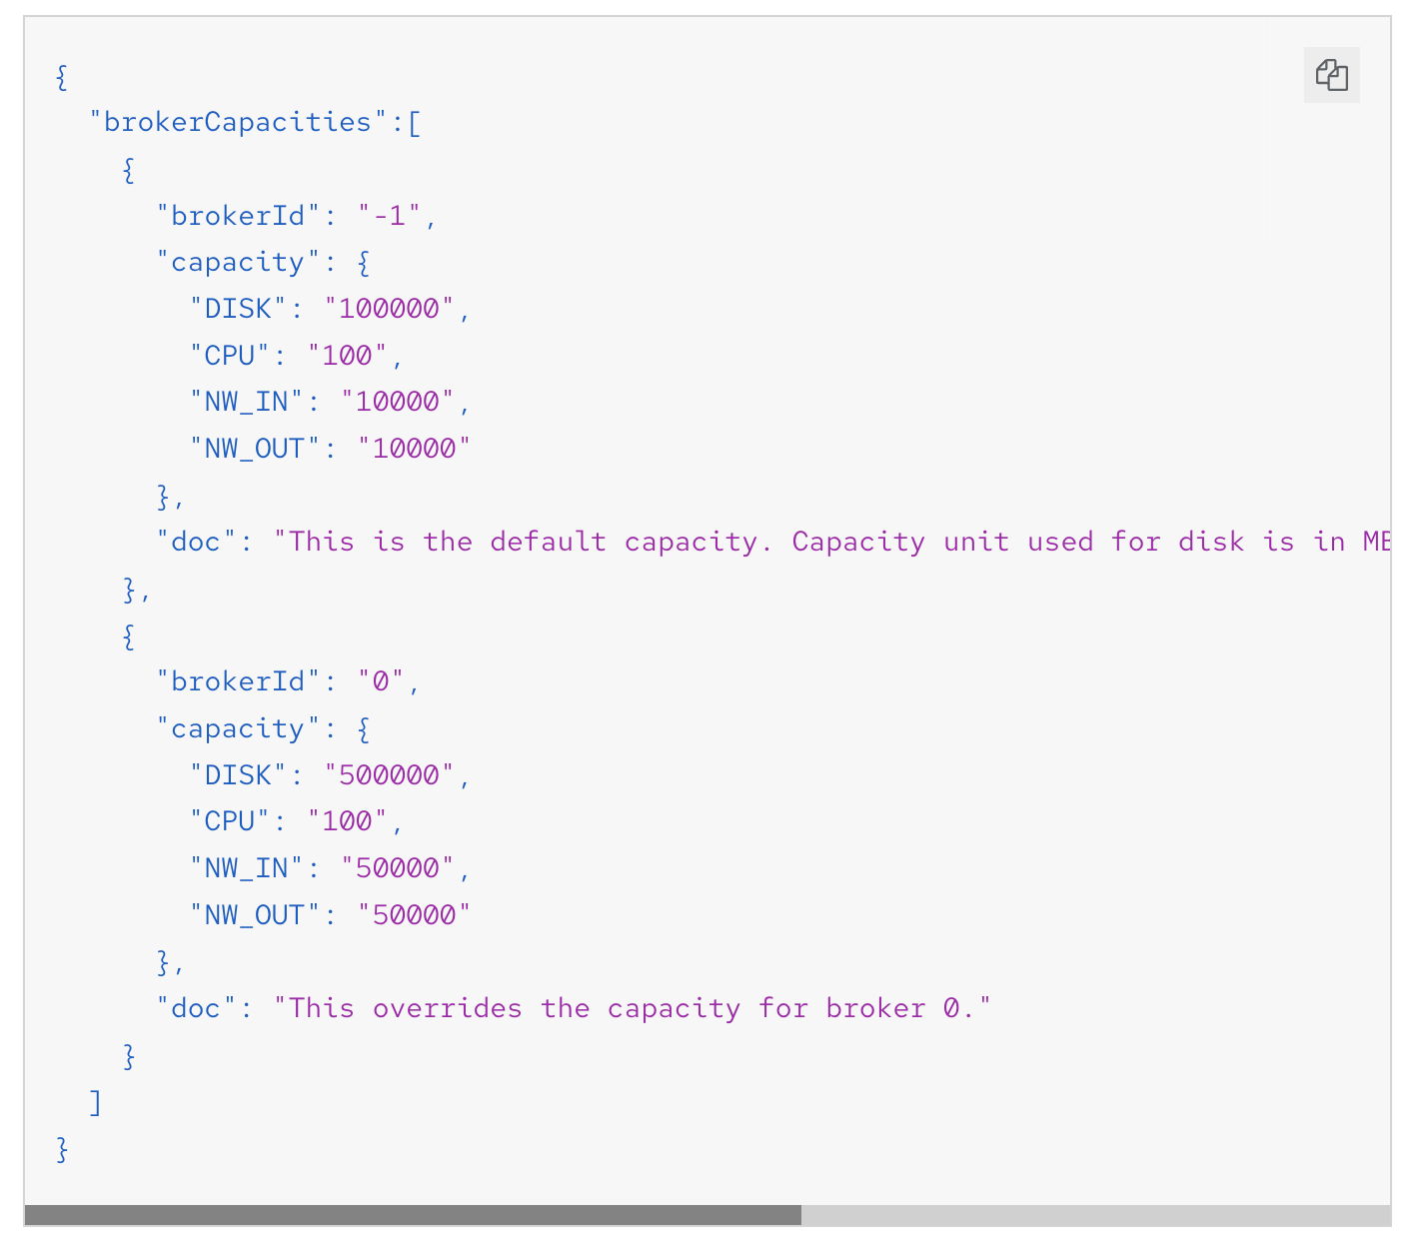
Capacity Configuration
Cruise Control uses capacity limits to determine if certain resource-based optimization goals are being broken.
You specify capacity limits for Kafka broker resources in one of the following three .json files in cruise-control/config:
capacityJBOD.json: For use in JBOD Kafka deployments (the default file).
capacity.json: For use in non-JBOD Kafka deployments where each broker has the same number of CPU cores.
capacityCores.json: For use in non-JBOD Kafka deployments where each broker has varying numbers of CPU cores.
Example capacity limits configuration
DISK: Disk storage in MB
CPU: CPU utilization as a percentage (0-100) or as a number of cores
NW_IN: Inbound network throughput in KB per second
NW_OUT: Outbound network throughput in KB per second
To apply the same capacity limits to every broker monitored by Cruise Control, set capacity limits for broker ID -1

Slide 33
Generate Proposals
Generate an optimization proposal using a POST request to the /rebalance, /add_broker, or /remove_broker
Example request to /rebalance using default goals
curl -v -X POST 'cruise-control-server:9090/kafkacruisecontrol/rebalance'
Example request to /add_broker that includes specified brokers
curl -v -X POST 'cruise-control-server:9090/kafkacruisecontrol/add_broker?brokerid=3,4'
Example request to /remove_broker that excludes specified brokers
curl -v -X POST 'cruise-control-server:9090/kafkacruisecontrol/remove_broker?brokerid=3,4'
Review the optimization proposal contained in the response.
The Cluster load after rebalance summary. If it meets your requirements, you should assess the impact of the proposed changes using the high level summary.
n inter-broker replica (y MB) moves indicates how much data will be moved across the network between brokers. The higher the value, the greater the potential performance impact on the Kafka cluster during the rebalance.
n intra-broker replica (y MB) moves indicates how much data will be moved within the brokers themselves (between disks). The higher the value, the greater the potential performance impact on individual brokers .
The number of leadership moves. This has a negligible impact on the performance of the cluster during the rebalance.

Slide 34
Approving an optimization proposal
Send a POST request to the /rebalance, /add_broker, or /remove_broker endpoint with the dryrun=false parameter
Example request to /rebalance
curl -X POST 'cruise-control-server:9090/kafkacruisecontrol/rebalance?dryrun=false'
Check the progress of the cluster rebalance using the /user_tasks endpoint. The cluster rebalance in progress has a status of "Active".
curl 'cruise-control-server:9090/kafkacruisecontrol/user_tasks'
Call check progress until status will change to “Completed”
Stop active rebalance, Send a POST request to the /stop_proposal_execution endpoint:
curl -X POST 'cruise-control-server:9090/kafkacruisecontrol/stop_proposal_execution'

Slide 35
Monitoring

Slide 36
Metrics
Kafka has built in metrics
Exposed natively using JMX protocol
Part of all Apache Kafka components
On RHEL, users can access it directly using their own JMX tools etc.
No JMX tools are part of AMQ Streams
Use the KAFKA_JMX_OPTS environment variable
export KAFKA_JMX_OPTS="-Dcom.sun.management.jmxremote=true
-Dcom.sun.management.jmxremote.port=<port>
-Dcom.sun.management.jmxremote.authenticate=false
-Dcom.sun.management.jmxremote.ssl=false"

Slide 37
Prometheus
Prometheus is a popular metrics and monitoring solution in the Cloud Native landscape
Pulls metrics out of HTTP endpoint
Has its own query language for querying the metrics
AMQ Streams do not include Prometheus deployment or support
It only supports the HTTP endpoint where Prometheus can connect and collect the metrics
Prometheus is also available as operator in OCP 4

Slide 38
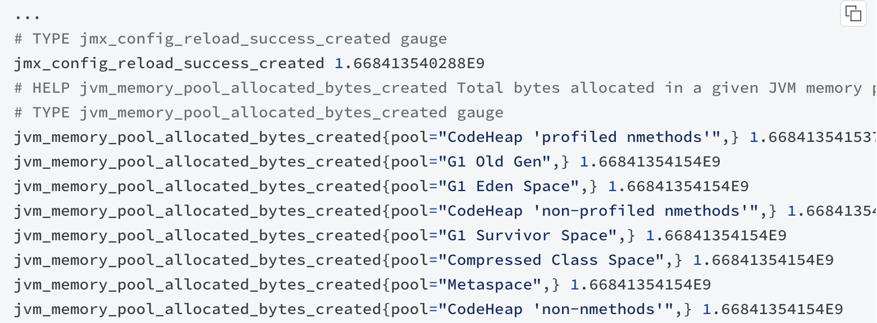
Prometheus
Strimzi / AMQ Streams on OCP has built in support for Prometheus endpoint
Using Prometheus JMX Exporter
Takes the JMX metrics and converts them to Prometheus format
Runs as Java agent inside the ZooKeeper / Kafka pods
Metrics can be configured in the Custom Resources
On RHEL, the JMX Exporter is part of our ZIP files, but users have to configure them on their own

Slide 39
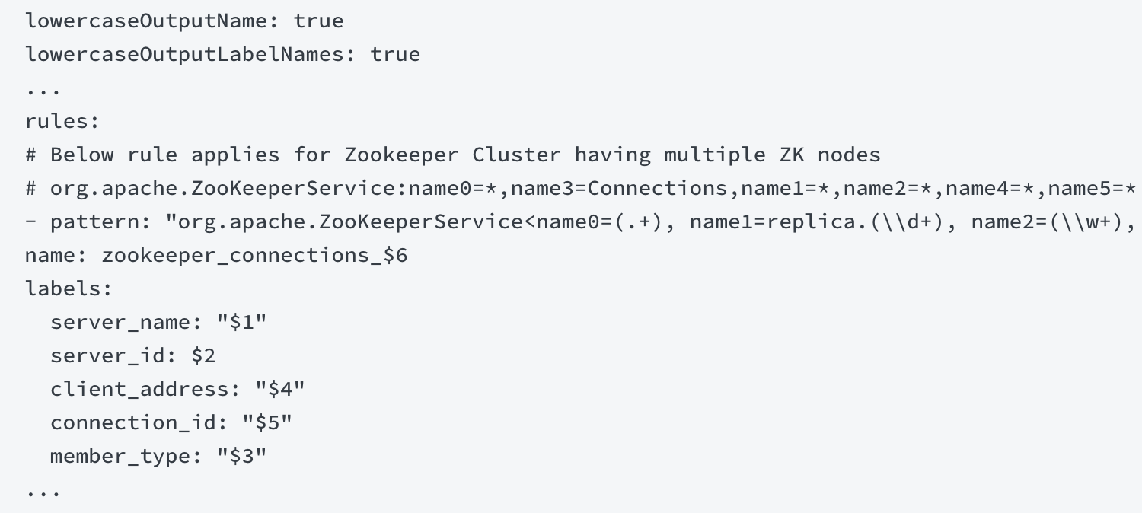
Prometheus JMX Exporter
verify jmx libraries in /libs path such as jmx_prometheus_javaagent-xxxx.redhat-xxx.jar
For zookeeper
create zookeeper prometheus config file such as zookeeper.yml and save file in config of zookeeper server node.
Edit environment variable for jmx exporter (7075 is port of jmx exporter) such as
export EXTRA_ARGS=$EXTRA_ARGS' -javaagent:/kafka/libs/jmx_prometheus_javaagent-0.16.1.redhat-00001.jar=7075:/kafka/config/zookeeper.yml'
Test with
curl http://localhost:7075/metrics

Slide 40
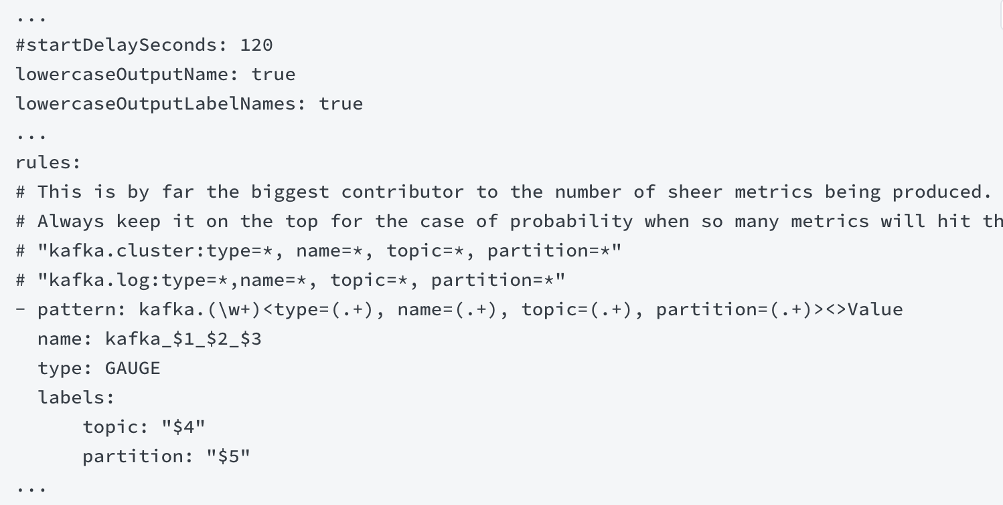
Prometheus JMX Exporter
For kafka
create kafka broker prometheus config file such as kafka_broker.yml and save file in /kafka/config of kafka broker node.
Edit environment variable for jmx exporter (7076 is port of jmx exporter) such as
export KAFKA_OPTS=$KAFKA_OPTS' -javaagent:/kafka/libs/jmx_prometheus_javaagent-0.16.1.redhat-00001.jar=7076:/kafka/config/kafka_broker.yml'
Test with
curl http://localhost:7076/metrics

Slide 41
Prometheus Alerting
Uses the Prometheus metrics to trigger alerts
Utilizes the already collected metrics
Alerts can be sent to different platforms
Supports features such as silenting the alerts etc.
Strimzi / AMQ Streams ships with several sample alert configurations
USers can extend them or modify them to best match their needs

Slide 42
Grafana
Visualizes the Prometheus metrics
Uses Prometheus as data source
Can be used to build dashboards with different metrics, charts, etc.
Strimzi / AMQ Streams ships with several example dashboards
Can be used as they are
Or modified by the customers
Grafana is not supported part of AMQ Streams

Slide 43
Lag Monitoring
Consumer Lag is an important metric which is missing in Kafka
Consumer lag measures how far is the consumer behind the head of the partition
Important metric to monitor the consumers
Consumers with constantly increasing lag might never catch up
Might be used as an indication to scale the consumer
Kafka Exporter is separate project which monitors the consumer lag and exposes it as Prometheus metric
On OCP it can be deployed through the custom resource
On RHEL it is part of our download ZIP files, but has to be configured by the user
run kafka exporter
/kafka/bin/kafka_exporter --kafka.version=3.2.3 --kafka.server=localhost:9092

Slide 44
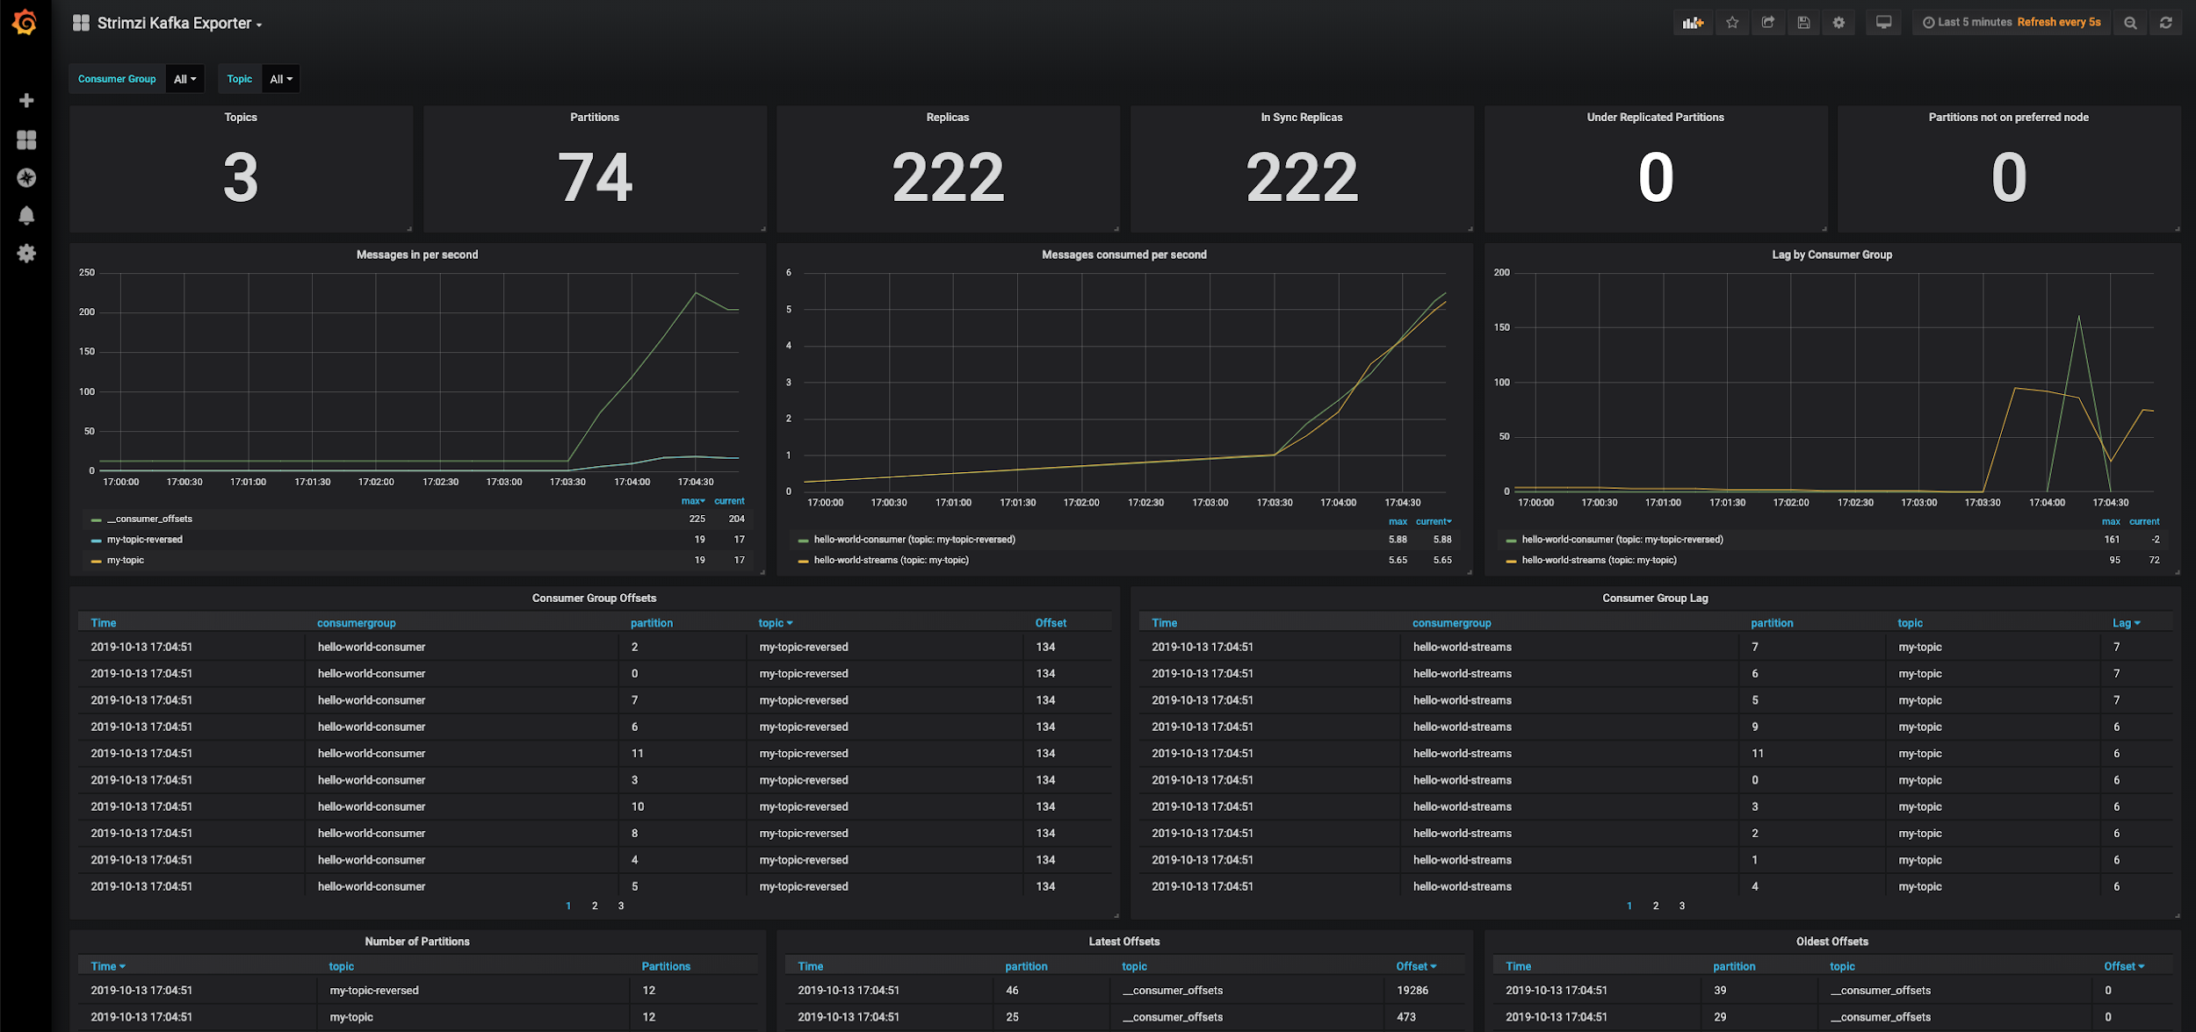
Lag Monitoring

Slide 45
Thank you

Slide 46
Disk Removal
Learn how to remove a disk from the configuration.
In case of a disk failure, a Kafka administrator can remove the disk and redistribute data across remaining disks to restore the desired replication factor.
Stop the broker that has a faulty disk:
Remove the log directories on the faulty disk from the broker:
Start the broker
Result: The disk is removed from the configuration. The Kafka broker redistributes data across the cluster.

Slide 47
Disk Replacement
Learn how to replace a disk.
In case of a disk failure, a Kafka administrator can replace the faulty disk with a new one.
Stop the broker that has a faulty disk
Replace the disk.
Mount the disk.
Set up the directory structure on the new disk the same way as it was set up on the previous disk.
Start the broker
Result: The disk is replaced. The Kafka broker re-creates topic partitions in the same directory by replicating data from other brokers.

Slide 48
Migrate brokers by modifying broker IDs in properties
Learn how to migrate brokers between hosts in a Kafka cluster by modifying broker IDs in properties.
In case of catastrophic hardware failure brokers can be moved to a new host in a Kafka cluster. The following steps walk you through broker migration by modifying broker IDs in meta.properties. Compared to migration with the help of the kafka-reassign-partitions tool, this method involves less manual work, but requires modifying an internal configuration file.
Important
Data intensive administration operations such as rebalancing partitions, adding a broker, removing a broker, or bootstrapping a new machine can cause significant additional load on the cluster. Therefore, Red Hat highly recommends that you migrate one broker at a time and migrate brokers when there is minimal load on the cluster
Verify that the cluster is healthy.
Verify that all replicas are in sync.
Start up the new broker as a member of the old cluster. This creates files in the data directory.
Stop both the new broker and the old broker that it is replacing.
Change broker.id of the new broker to the broker.id of the old one both in properties.
Optional: Run rsync to copy files from one broker to another.
Start up the new broker. When started the new broker re-replicates data from the other nodes.
Result: The Kafka broker is migrated to a new host.

Slide 49
Use rsync to copy files from one broker to another
Learn how to use rsync to copy over all data from an old broker to a new broker.
You can run rsync command to copy over all data from an old broker to a new broker, preserving modification times and permissions. Using rsync allows you to avoid having to re-replicate the data from the leader.
Ensure that the disk structures match between the two brokers, or verify the properties file between the source and destination brokers.
Run the following command on destination broker:
rsync -avz
src_broker:src_data_dir
dest_data_dir
If you plan to change the broker ID, edit properties.
Data from the source broker is copied over to the destination broker.

